Slide 1
Server Instructions
You can use the server http://isi-summer.csr.unibo.it/ to:
deploy your projects;
access the data from the cameras to get the number of students in a room (see the detailed instructions in the google drive folder).
Just for your information, the server has Debian as operative system with:
mysql Ver 8.0.16
Python 2.7.13
PHP 7.0.33
Node.js 12.6.0

Slide 2
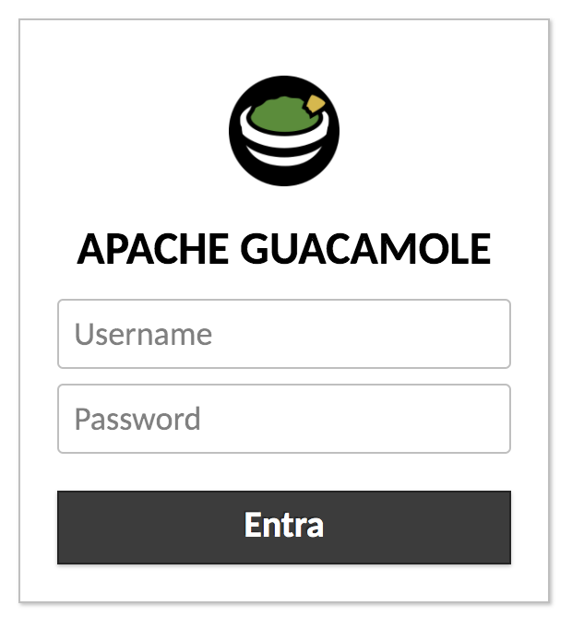
Instructions to access the server
To access the server:
Open the browser at https://csi-rlab.campusfc.unibo.it/
Login with your unibo credential
Mail @studio.unibo.it
It means login

Slide 3
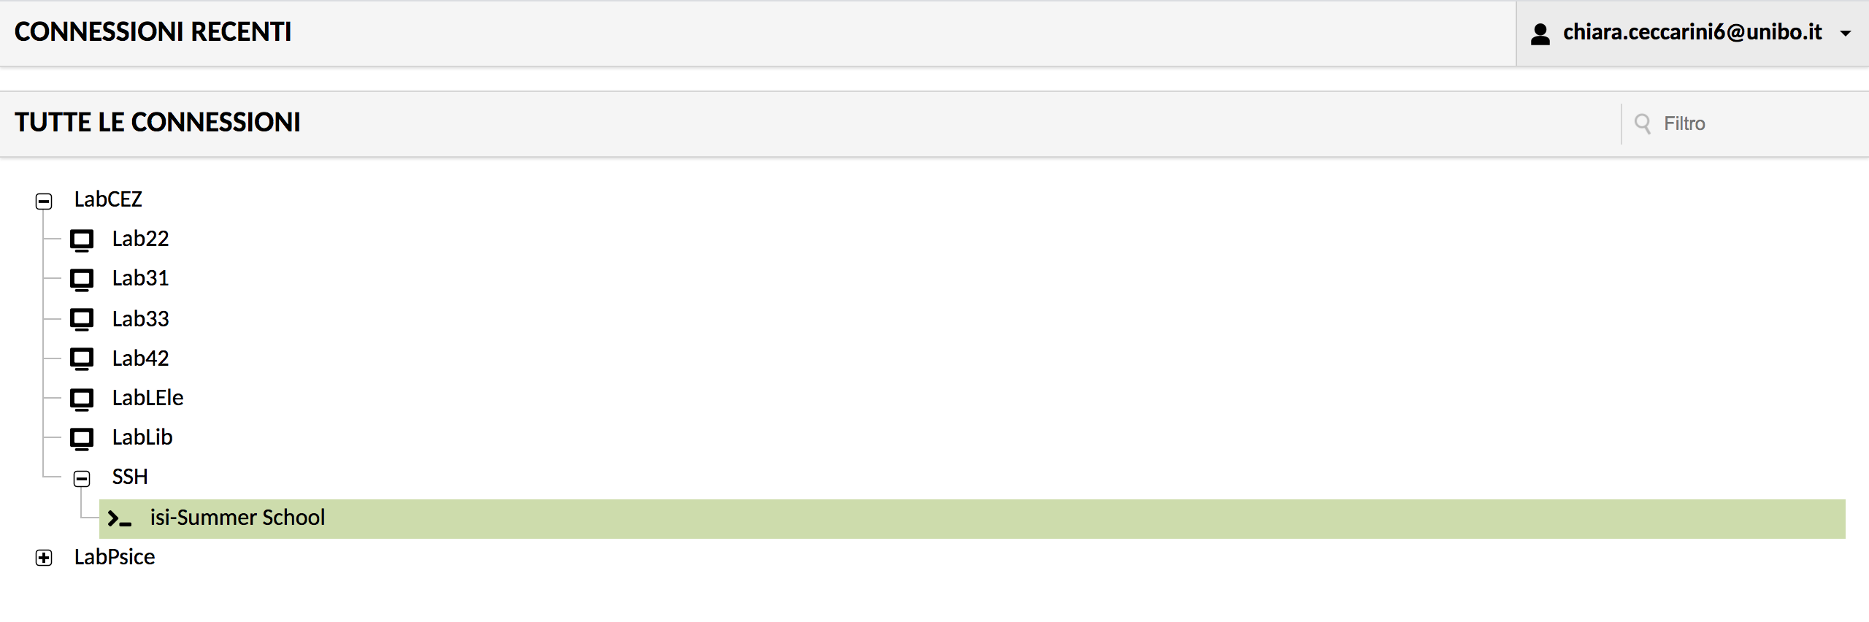
Instructions to access the server
3. Select LabCez → SSH → isi-Summer School

Slide 4
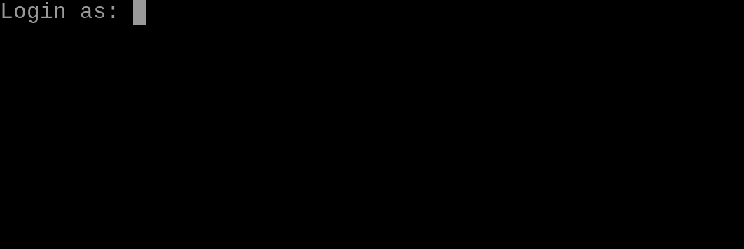

Instructions to access the server
4. Then log into the server with your unibo credentials (mail first and then the password)

Slide 5
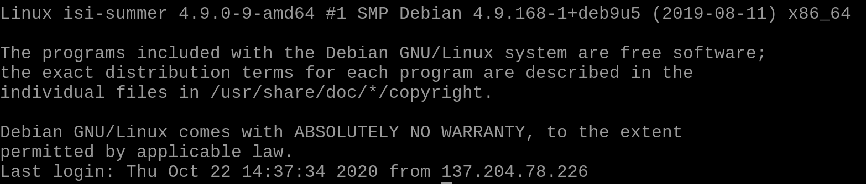
Instructions to access the server

